Slide 1



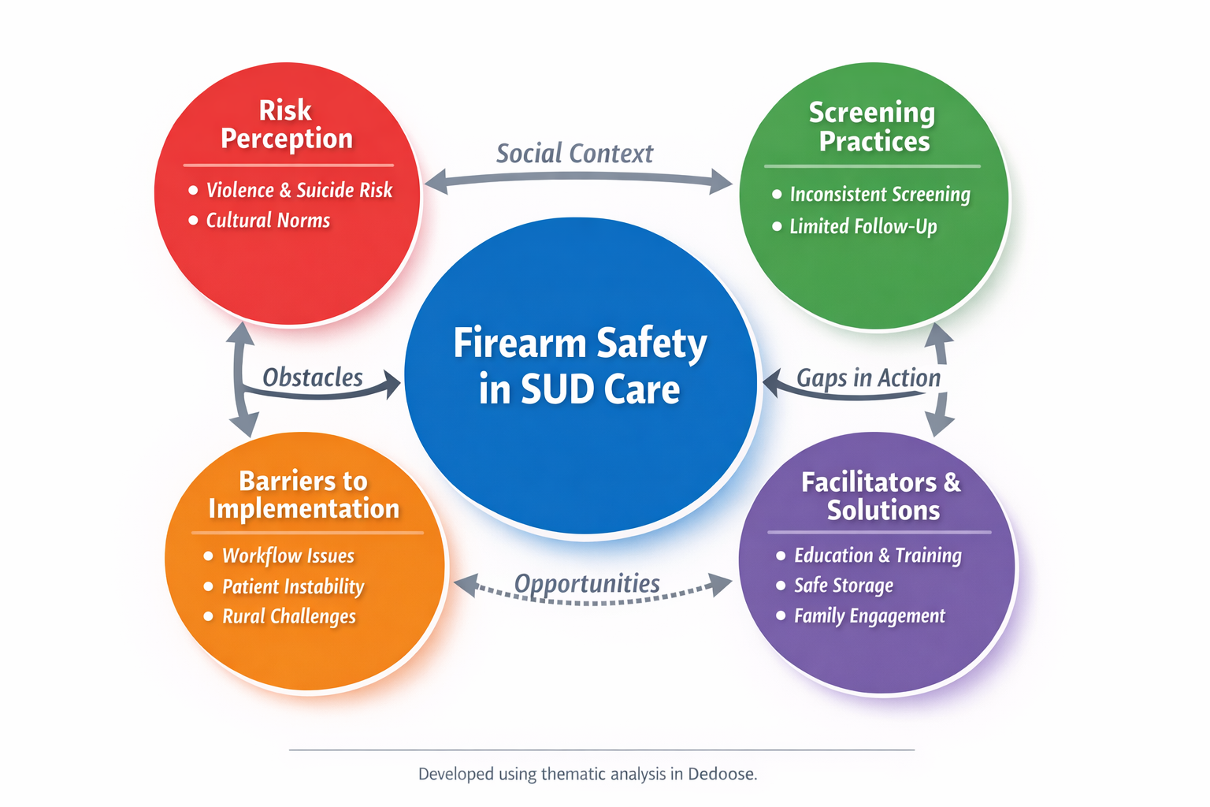
Addressing Firearm Risks Among Rural Residents with
Substance Use Disorder: A Preliminary Qualitative Analysis
Alexa C. Curtis¹, Erin Grinshteyn², Reshika Rimal¹
¹ Orvis School of Nursing, University of Nevada, Reno
² University of San Francisco
Background and Introduction
Results
Discussion
Firearm injury = major U.S. public health issue
SUD ↑ risk of suicide and violence
Whether screening occurs and what is assessed for firearm access varies across providers and practice settings
Rural provider perspectives on firearm risk among individuals with substance use disorder remain underexplored
Objective: To explore provider perspectives on firearm risk, screening, and intervention opportunities in rural SUD care.
Discussion & Conclusion
Introduction & Background
Theme 2: Screening Practices
Highly inconsistent across settings
Screening practices vary (routine vs none)
Screening content varies; there is no standardized screener
Screening rarely leads to structured intervention
💬 “None of our mandated screenings include firearm questions.”
Firearm risk is recognized by providers.
Screening practices are inconsistent and unstructured.
Barriers operate at multiple levels, particularly workflow burden and patient-related factors.
Rural cultural norms and social instability further complicate implementation.
Theme 1: Risk Perception
High awareness of firearm-related harm
Perceptions vary by clinical setting and rural context
Firearms are sometimes viewed as protective
💬 “If a patient reports suicidal ideation, firearm access is addressed.”
Theme 3: Barriers to Implementation
Workflow burden (most frequent)
Patient disclosure and Social instability
Cultural norms and perceived legal constraints
💬 “It must be feasible given our documentation burden.”
Theme 4: Facilitators & Opportunities
Education and counseling are most commonly suggested
Safe storage and family involvement are suggested but rarely integrated into routine care
💬 “If we ask, there should be a next step… done consistently.”
Future Directions
Standardize firearm screening protocols.
Integrate clear clinical follow-up pathways.
Train providers in culturally sensitive care.
Address workflow barrier through system support.
Expand research in rural populations.
Complete interviews and coding, with independent coding for reliability.
Methods
Conceptual Model of Firearm Safety in SUD Care
Qualitative semi-structured interviews (n = 6)
Participants: Rural Nevada SUD providers using snowball sampling
Qualitative Analysis: Preliminary thematic analysis was conducted.
126 excerpts coded using Dedoose
Iterative codebook refinement
Preliminary findings suggest firearm risk is widely recognized, but implementation is limited due to workflow and system-level constraints.

