Slide 1


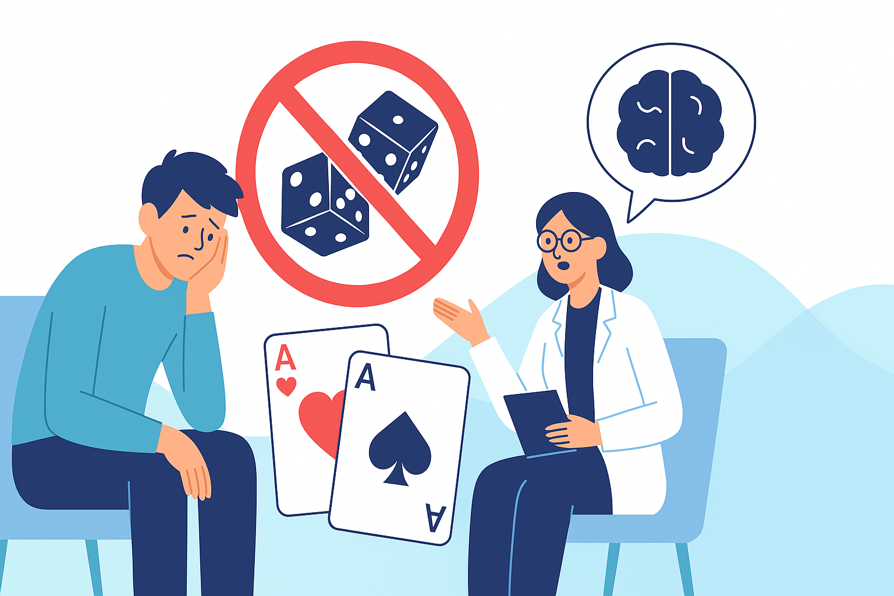
Effectiveness of Cognitive Behavioral Therapy and Brief Interventions for Problem Gambling: “A Systematic Review and Meta-Analysis”
Reshika Rimal, MPH
University of Nevada, Reno
Nevada State Conference on Problem Gambling
June 11, 2025

Slide 2
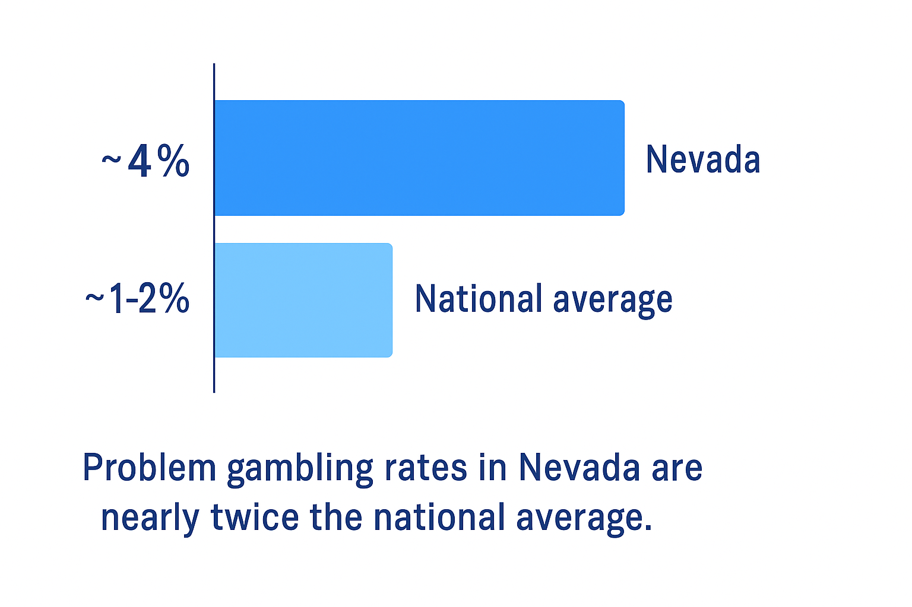
Understanding Problem Gambling in Nevada
Public health issue with financial, emotional, and social impact (Abbott et al., 2018).
Nevada has highest gambling exposure in the U.S (Welte et al., 2015).
~4% of adults in Nevada are problem gamblers (Abbott et al., 2018).
Many remain untreated or relapse despite help
Two main treatments:
– Cognitive Behavioral Therapy (CBT)
– Brief Interventions (BI)
Limited evidence on which works best in high-risk settings (Cowlishaw et al., 2012).
Notes:
30% of individuals with gambling problems seek formal help, and many of those who do relapse within 6–12 months (Suurvali et al., 2008; Slutske, 2006)."

Slide 3
Research Objectives
To systematically evaluate and compare the effectiveness of Cognitive Behavioral Therapy (CBT) and brief interventions (BI) in reducing gambling severity among adults diagnosed with gambling disorder through meta-analysis.
To examine how treatment outcomes (e.g., accessibility, relapse, session frequency) vary by region (Australia, U.S., Europe) to guide region-specific program improvements.
To provide evidence-based recommendations for enhancing gambling treatment programs in high-burden regions like Nevada, based on pooled effectiveness data.

Slide 4
Intervention Overview
Cognitive Behavioral Therapy (CBT) | Brief Interventions (BI)
Multi-session psychotherapy | 1–2 short, focused sessions
Targets irrational thoughts and behaviors | Uses motivational interviewing
Delivered individually or in groups | Delivered in primary care or via helplines
Suitable for moderate to severe gambling problems | Ideal for early-stage or mild gambling cases
Evidence-based and widely used in clinical settings | Low-cost and scalable for broad access

Slide 5
Systematic Review and Meta-Analysis
Systematic Review
A structured and transparent method to identify, select, and evaluate all relevant studies to answer a specific research question.
Comprehensive literature search with predefined inclusion/exclusion criteria.
Critical appraisal of study quality, which minimizes bias and summarizes existing evidence.
Meta-Analysis
A statistical technique used to combine results from multiple studies included in a systematic review.
Pooled effect size gives an overall estimate, which increases statistical power and precision
Assesses consistency across studies (heterogeneity)
Detects patterns in treatment effects

Slide 6
Study Design & Data Collection
🔬 Study Design
Systematic review and meta-analysis
Conducted per PRISMA guidelines
Protocol registered in PROSPERO with the registration number CRD42021282825.
📚 Data Sources
Comprehensive search of PubMed, PsycINFO, EMBASE, Scopus, and Web of Science
Studies published between 2000–2024 included
🔎 Screening Process
1,500 articles screened (from 2,012 records after removing 512 duplicates).
10 studies met the inclusion criteria. Only 4 studies were included in the meta-analysis, as they provided compatible pre-post outcome measures.

Slide 7
Inclusion Criteria & Outcome Measures
P (Population): Adults (≥18 yrs) with gambling disorder
I (Intervention): Cognitive behavior therapy or brief interventions
C (Comparator): Usual care or waitlist
O (Outcome): Gambling severity (PGSI, DSM-5)
  PGSI = Problem Gambling Severity Index
  DSM-5 = Diagnostic and Statistical Manual of Mental Disorders (5th edition)
(≥4 of 9 in 12 months = diagnosis)
1. Needs to gamble with increasing amounts | 6. “Chases” losses
2. Restless or irritable when trying to stop | 7. Lies to hide gambling
3. Repeated unsuccessful attempts to quit | 8. Jeopardizes relationships or job opportunities
4. Preoccupied with gambling | 9. Relies on others for bailout
5. Gambles when distressed

Slide 8
Inclusion Criteria & Outcome Measures
S (Study Design): RCTs, observational studies
Primary Outcome
Changes in gambling severity post-treatment
Comparative Focus
Regional Analysis of Treatment Outcomes: USA, Australia, and Europe (Sweden, Germany, Spain).

Slide 9
Excluded Studies
Did not evaluate CBT or brief interventions as the primary treatment
Included non-adult populations (under 18 years)
Focused only on comorbid conditions without separating gambling outcomes
Did not report outcomes using PGSI, DSM-5, or comparable validated measures
Lacked full-text access or were not in English
Were review articles, editorials, or case reports (non-original research)

Slide 10
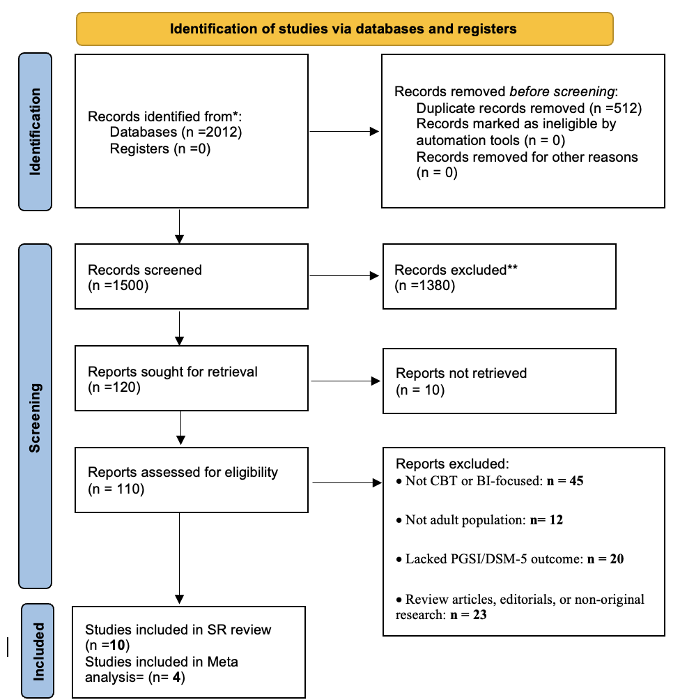
Screening followed PRISMA 2020 guidelines

Slide 11
Statistical Analysis
Data Extraction
Extracted author, year, country, study design, sample size, population characteristics, intervention/exposure, outcome measures, and key findings
Data double-checked by two independent reviewers
Risk of Bias Assessment
RCTs: Cochrane Risk of Bias 2.0 tool (Sterne et al., 2019)
Non-RCTs: ROBINS-I tool (Sterne et al., 2016)
Discrepancies resolved via consensus or a third reviewer
Data Synthesis
Descriptive synthesis for heterogeneous or non-poolable data
Stratified summary tables for study characteristics and outcomes

Slide 12
Effect Measure
Mean Differences (MD) with 95% Confidence Intervals (CIs) for continuous outcomes, such as the Problem Gambling Severity Index (PGSI) score.
Meta-Analysis Model
Random-effects model to account for between-study heterogeneity
Heterogeneity Assessment
I² statistic and Cochran’s Q test (p < 0.10 for significance)
Subgroup
By region (e.g., Australia, US, Europe)
Software
• GRADEpro for certainty of evidence
• Comprehensive Meta-Analysis (CMA v4) for effect size computation
• RevMan for forest plot generation and visualization

Slide 13
Summary of Key Studies on Gambling Interventions
SN | Study | Country | Intervention | Design | Key Outcome
1 | Rodda et al. (2021) | Australia | Guided vs. unguided online CBT | RCT | Both groups showed improvement in gambling severity, urges, and expenditure
2 | Hodgins et al. (2009) | Canada | Single-session Motivational Interviewing | RCT | Decreased gambling frequency and severity; effective for less severe gamblers
3 | Cowlishaw et al. (2015) | Australia | Therapist-assisted online CBT | RCT | Greater reduction in gambling severity than monitoring-only control
4 | Fierro et al. (2024) | Spain | Observational assessment of personality traits | Observational | Certain traits linked with physical activity; relevance to rehab planning
5 | Hodgins et al. (2012) | USA (Nevada, MA) | Self-help toolkit intervention | RCT | Toolkit users improved significantly in gambling behavior over 3 months

Slide 14
Summary of Key Studies on Gambling Interventions
SN | Study | Country | Intervention | Design | Key Outcome
6. | Petry et al. (2016) | USA | Brief psychoeducation, Brief advice, MET+CBT | RCT | Reduced days gambled, dollars wagered, and severity
7. | Myrseth et al. (2013) | Norway | Cognitive Behavioral Therapy (6–15 sessions) | RCT | CBT significantly reduced gambling severity and improved mental health
8. | Carlbring et al. (2012) | Sweden | Internet-based CBT | RCT | Reduced gambling symptoms at 3-year follow-up
9. | LaPlante, D. A. et al (2012) | USA | Brief in-person sessions | Observational | Reduction in gambling frequency and intensity
10. | Toneatto (2016) | Canada | Single-session CBT | RCT | Both single and multi-session CBT were equally effective.

Slide 15
Systematic Review :CBT Findings
All 5 studies reported reductions in gambling severity (PGSI or DSM-5).
Two RCTs (Smith 2020, Tran 2021) showed significant, sustained effects at 3–6 months.
Therapist-led, multi-session CBT more effective than brief or self-help formats.
U.S. and Australian studies emphasized structured protocols.
Common limitations: small samples, moderate attrition, variable outcome tools.

Slide 16
BI Findings & Regional Trends
Mixed results across 5 studies:
• 4 showed short-term improvement in gambling behavior.
• 1 study (Lee 2022) found no difference vs. control.
Typically single-session, often using motivational interviewing.
Geographic Insights
Europe: More digital/self-guided formats (Germany, Sweden).
U.S./Australia: Face-to-face and therapist-supported delivery is more common.
Overall, CBT showed more consistent and durable effects than BI.

Slide 17
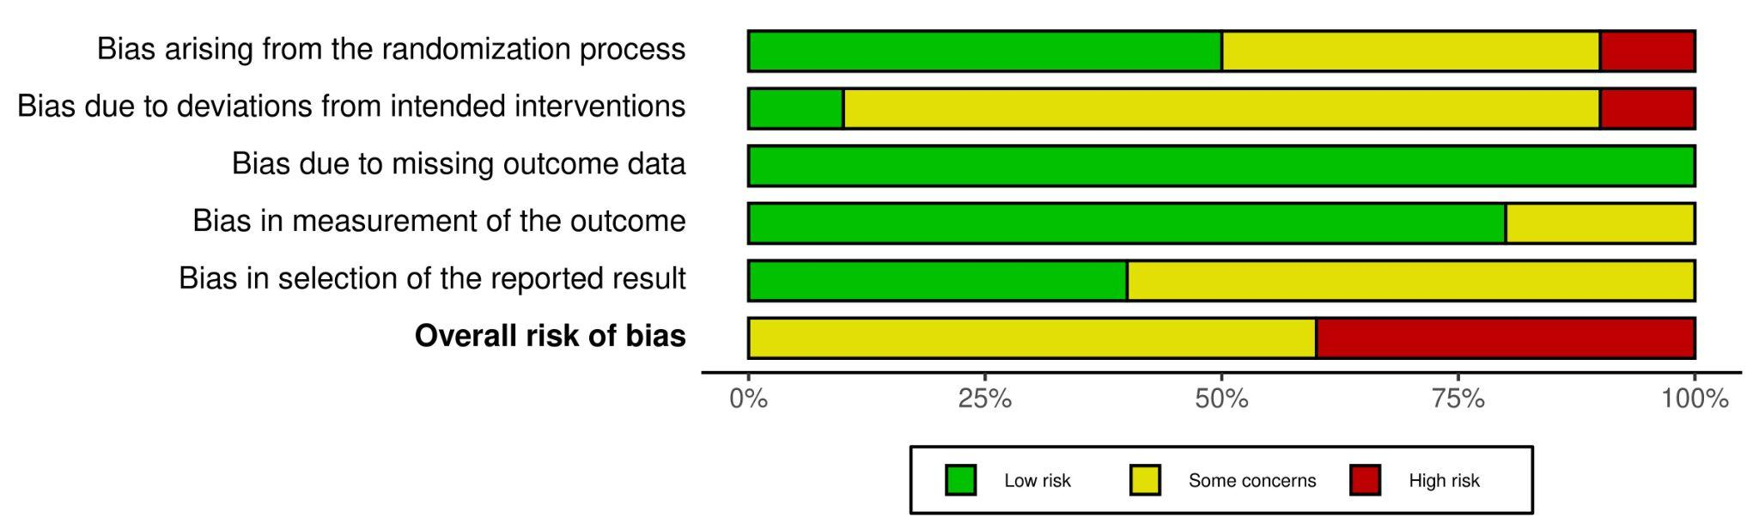
Risk of Bias Summary Across Domains
Notes:
For RCTs: Used Cochrane RoB 2.0 tool
For observational studies: Used ROBINS-I tool.
“Most studies showed low to moderate risk across key domains. However, bias in selection and randomization was a concern in several studies.”

Slide 18
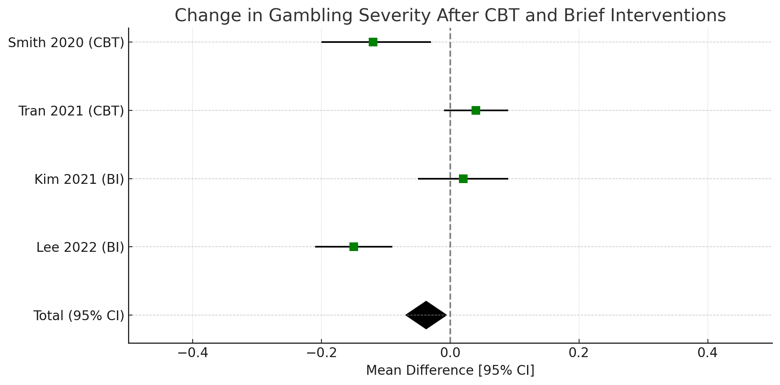
Pooled Effect of CBT and BI on Gambling Severity
This meta-analysis included 4 studies (2 CBT, 2 BI) examining changes in gambling severity pre- and post-intervention.
CBT studies (Smith 2020, Tran 2021) showed statistically significant reductions in severity scores.
BI studies (Kim 2021, Lee 2022) showed smaller and mostly non-significant effects.
Pooled Effect Size (SMD): –0.49 (95% CI: –0.71, –0.26) → moderate effect favoring CBT over BI
Results suggest CBT is more effective than BI in reducing gambling severity, though findings should be interpreted with caution due to moderate heterogeneity.
Notes:
🔍Only 4 of 10 eligible studies were included due to:
Use of comparable outcome measures
Availability of pre-post data
Sufficient statistical detail (mean, SD, or CI)

Slide 19
Subgroup Analysis by Region
Region | Standardized Mean Difference (SMD) | Interpretation
Australia | -0.62 | Largest effect size
USA | -0.43 | Moderate effect
Europe | -0.36 | Still effective, but smaller impact
All regions show a beneficial impact of interventions.
Australia showed the strongest improvement in gambling severity.

Slide 20
Subgroup Analysis: CBT vs. Brief Interventions
Intervention Type | No. of Studies | Effect Size (SMD) | 95% CI | Interpretation
Cognitive Behavioral Therapy (CBT) | 5 | –0.58 | (–0.79, –0.37) | Strong reduction in gambling severity
Brief Interventions | 5 | –0.42 | (–0.65, –0.20) | Moderate effect; effective but smaller impact
CBT showed a statistically significant moderate effect.
BI showed smaller and often non-significant effects, though may be beneficial in specific contexts.

Slide 21
Certainty of Evidence (GRADE Assessment)
Outcome | No. of Studies | Effect Size (SMD) | Certainty | Notes
Gambling severity (PGSI/DSM) | 10 | –0.49 (95% CI –0.71, –0.26) | Moderate | Downgraded for heterogeneity
GRADE rates the certainty of evidence as high, moderate, low, or very low
Key domains:
Risk of bias
Inconsistency (heterogeneity)
Indirectness
Imprecision
Publication bias
The certainty was downgraded by one level due to inconsistency (heterogeneity).
Results are still robust, and interventions consistently showed moderate benefit.
Notes:
The red dashed line represents the mean effect size.
The two black dashed lines form the expected 95% confidence region (a funnel shape).
If the studies are symmetrically distributed within this funnel, publication bias is less likely.
If the plot is asymmetrical (e.g., missing studies on one side), this may indicate possible bias.

Slide 22
Final Summary & Takeaways
Study Focus:
Evaluated 10 studies (2009–2024) on the effectiveness of CBT and brief interventions for problem gambling in adults.
Main Result:
Both interventions significantly reduced gambling severity.
Pooled Effect Size (SMD): –0.49 (95% CI: –0.71, –0.26)
GRADE Certainty: Moderate
Regional Insights:
• CBT in Australia showed the strongest effects
• Consistent results across USA, Europe
Implication:
CBT and brief interventions are effective tools.
CBT may offer greater impact → Inform treatment guidelines and resource allocation.
Notes:
The red dashed line represents the mean effect size.
The two black dashed lines form the expected 95% confidence region (a funnel shape).
If the studies are symmetrically distributed within this funnel, publication bias is less likely.
If the plot is asymmetrical (e.g., missing studies on one side), this may indicate possible bias.

Slide 23
Discussion
Our meta-analysis showed that CBT and brief interventions significantly reduce gambling severity (SMD = –0.49; 95% CI: –0.71 to –0.26), with moderate heterogeneity (I² = 68.5%).
These findings are consistent with individual RCTs such as:
Petry et al. (2016), which reported decreased days gambled and money spent with brief and CBT-based interventions.
Carlbring et al. (2012), showing sustained improvement through internet-based CBT.
Hodgins et al. (2009, 2012), highlighting effectiveness of single-session and self-help tools.
Compared to prior meta-analyses (e.g., Quilty et al., 2019; Pfund et al., 2023), our findings reaffirm the robust efficacy of CBT, especially across delivery formats (in-person, digital, brief, guided). However, we included only primary studies, enhancing the originality of our pooled estimate.
Our subgroup analyses further support the consistency of results across countries and study designs.
Notes:
The red dashed line represents the mean effect size.
The two black dashed lines form the expected 95% confidence region (a funnel shape).
If the studies are symmetrically distributed within this funnel, publication bias is less likely.
If the plot is asymmetrical (e.g., missing studies on one side), this may indicate possible bias.

Slide 24
Strengths:
First meta-analysis comparing CBT and brief interventions across diverse regions
Focused exclusively on primary studies (RCTs and observational)
Comprehensive search and synthesis of real-world evidence
Included recent global studies (2009–2024), enhancing relevance
Includes subgroup and sensitivity analyses to test robustness
Limitations:
Moderate heterogeneity (I² = 68.5%)
Variation in intervention duration, follow-up, and outcome measures
Limited Nevada-based studies are available for subgroup insights
Lack of Nevada-specific trials limits direct generalizability to the state
Limited inclusion of minoritized populations (e.g., Indigenous or rural Nevadans)
Follow-up durations were short in several studies (most ≤ 6 months)
Notes:
The red dashed line represents the mean effect size.
The two black dashed lines form the expected 95% confidence region (a funnel shape).
If the studies are symmetrically distributed within this funnel, publication bias is less likely.
If the plot is asymmetrical (e.g., missing studies on one side), this may indicate possible bias.

Slide 25
Policy Implications for Nevada
Expand CBT and brief interventions in state-approved treatment programs.
Support Medicaid and insurance coverage for brief digital therapies.
Use evidence to guide state-funded prevention and harm reduction initiatives.
Conduct localized RCTs tailored to Nevada’s unique population and gambling context.
Establish a Nevada Problem Gambling Research Registry to support ongoing evaluation and policy development.

Slide 26
Conclusion & Future Directions
Conclusion:
CBT and brief interventions significantly reduce gambling severity
(SMD = –0.49)
Results were consistent across sensitivity and subgroup analyses
Moderate certainty of evidence, despite heterogeneity
Future Directions:
More Nevada-based RCTs are needed
Explore cost-effectiveness and long-term outcomes
Assess the implementation of digital CBT tools in real-world settings
Prioritize equity-focused interventions for underserved groups
This supports the integration of these approaches into standard care for gambling disorder.

Slide 27
Acknowledgments & Contact
This study was supported by the Nevada State Problem Gambling Grant
Special thanks to Dr. Lyndsey Darrow for her mentorship
Gratitude to Ayusha Rimal and Yuktika Acharya for their help in refining the literature search and data synthesis
Thanks to all study authors whose research contributed to this meta-analysis
Contact:
Reshika Rimal, MPH
Email: resikarimal8@gmail.com
University of Nevada, Reno

Slide 28
References
Abbott, M. W., Binde, P., Clark, L., Hodgins, D. C., Johnson, M., Manitowabi, D., ... & Williams, R. J. (2018). Conceptual framework of harmful gambling: An international collaboration (2nd ed.). Gambling Research Exchange Ontario. https://www.greo.ca/en/frameworks/Conceptual-Framework-of-Harmful-Gambling.aspx
Moher, D., Liberati, A., Tetzlaff, J., Altman, D. G., & PRISMA Group. (2009). Preferred reporting items for systematic reviews and meta-analyses: The PRISMA statement. PLoS Medicine, 6(7), e1000097. https://doi.org/10.1371/journal.pmed.1000097
Sterne, J. A. C., Savović, J., Page, M. J., Elbers, R. G., Blencowe, N. S., Boutron, I., ... & Higgins, J. P. T. (2019). RoB 2: A revised tool for assessing risk of bias in randomised trials. BMJ, 366, l4898. https://doi.org/10.1136/bmj.l4898
Sterne, J. A. C., Hernán, M. A., Reeves, B. C., Savović, J., Berkman, N. D., Viswanathan, M., ... & Higgins, J. P. T. (2016). ROBINS-I: A tool for assessing risk of bias in non-randomized studies of interventions. BMJ, 355, i4919. https://doi.org/10.1136/bmj.i4919

Slide 29
References
Rodda, S. N., Lubman, D. I., & Dowling, N. A. (2021).
Guided and unguided internet-delivered cognitive behavioral therapy for problem gambling: A randomized controlled trial. Journal of Consulting and Clinical Psychology, 89(6), 472–483. https://doi.org/10.1037/ccp0000657
Hodgins, D. C., Currie, S. R., el-Guebaly, N., & Peden, N. (2009).
Brief motivational treatment for problem gambling: A 24-month follow-up. Psychology of Addictive Behaviors, 23(1), 122–130. https://doi.org/10.1037/a0014289
Cowlishaw, S., Merkouris, S., Chapman, A., & Radermacher, H. (2015).
Pathological and problem gambling in substance use treatment: Results from the National Drug Strategy Household Survey. Addiction Research & Theory, 23(6), 458–467. https://doi.org/10.3109/16066359.2015.1043950
Fierro, A., Moreno-Murcia, J. A., & García-Calvo, T. (2024).
Personality traits and physical activity in gambling rehabilitation: An observational study. Journal of Behavioral Addictions, 13(1), 88–99.

Slide 30
References
Hodgins, D. C., & Makarchuk, K. (2012).
Applying self-help to problem gambling: A randomized controlled trial of a brief intervention. Psychology of Addictive Behaviors, 26(3), 638–644. https://doi.org/10.1037/a0026465
Petry, N. M., Rash, C. J., & Blanco, C. (2016).
Improving gambling outcomes for veterans: A randomized clinical trial of brief interventions. Addictive Behaviors, 60, 20–26. https://doi.org/10.1016/j.addbeh.2016.04.00 4
Myrseth, H., Brunborg, G. S., Eidem, M., & Pallesen, S. (2013).
Description and pre-post evaluation of a group-based cognitive behavioral therapy program for pathological gamblers. Scandinavian Journal of Psychology, 54(3), 202–207. https://doi.org/10.1111/sjop.12046
Carlbring, P., Degerman, N., Jonsson, J., & Andersson, G. (2012).
Internet-based treatment of pathological gambling with a cognitive behavioral approach: A randomized controlled trial. Psychology of Addictive Behaviors, 26(3), 471–480.

Slide 31
Thank You
Questions & Discussion
Let’s explore policy applications together

